Slide 1


Pizza Sales Analysis
Using SQL
By Shaun Mia

Slide 2

Hello Everyone
My name is Shaun Mia, and I have developed a MySQL project in which I utilized MySQL Server Management Studio to analyze pizza sales data. This analysis is based on four datasets that provide valuable insights into various aspects of pizza sales performance. To uncover these insights, I addressed 13 key questions, which helped in understanding sales trends, customer behavior, and overall business performance.

Slide 3
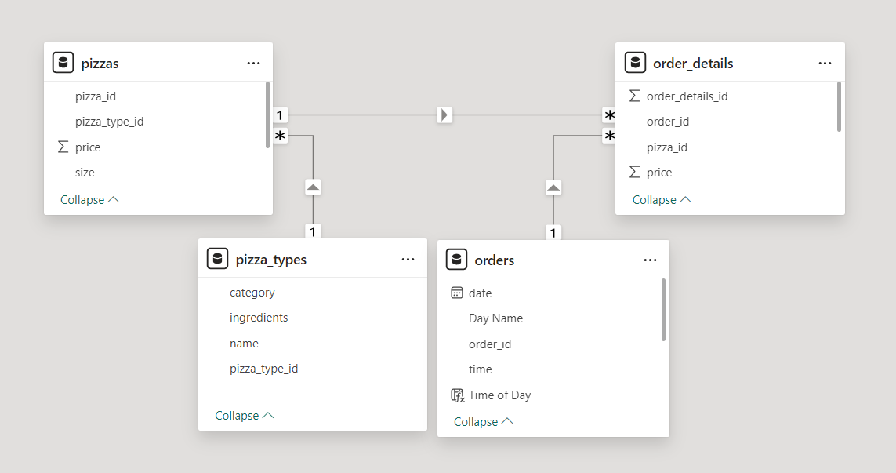
Schema

Slide 4
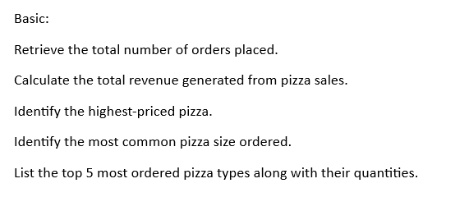
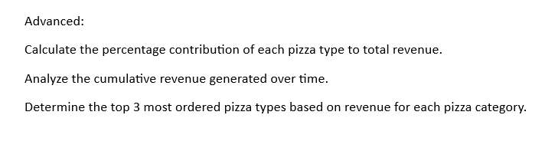
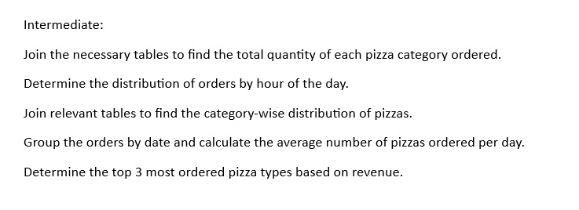
All Questions

Slide 5


Retrieve the total number of orders placed.

Slide 6
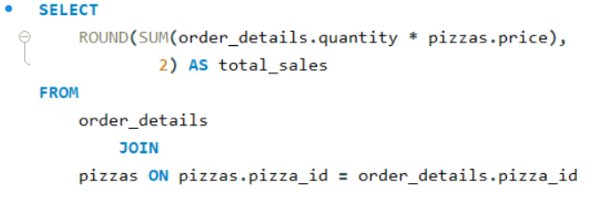

Calculate the total revenue generated from pizza sales

Slide 7
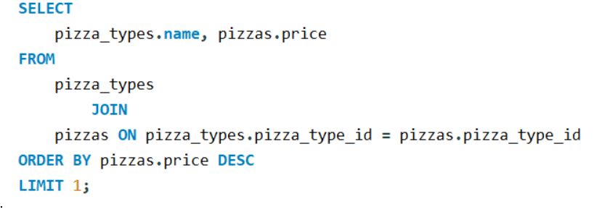

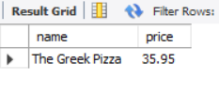
Identify the highest-priced pizza

Slide 8
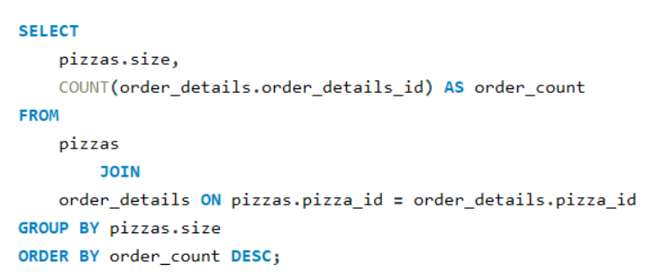
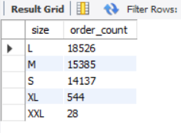
Identify the most common pizza size ordered

Slide 9
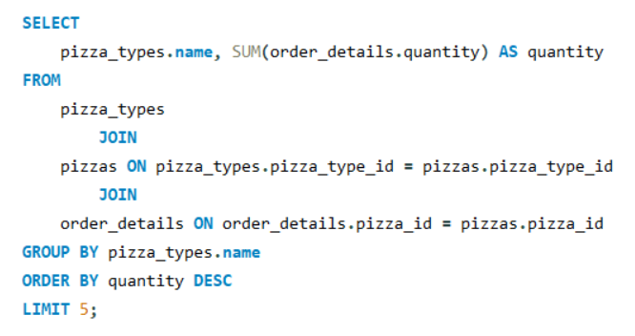
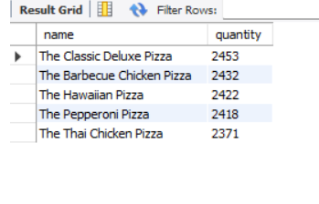
List the top 5 most ordered pizza types along with their quantities

Slide 10
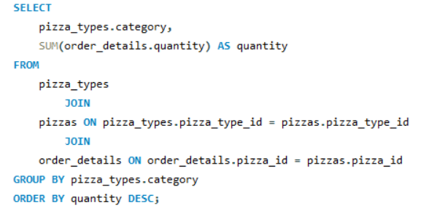
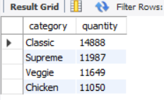
Join the necessary tables to find the total quantity of each pizza category ordered.

Slide 11
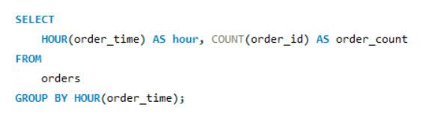
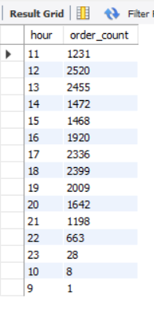
Determine the distribution of orders by hour of the day.

Slide 12
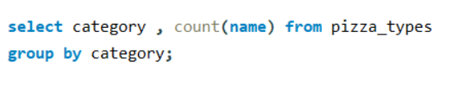
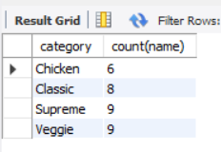
Join relevant tables to find the category-wise distribution of pizzas.

Slide 13
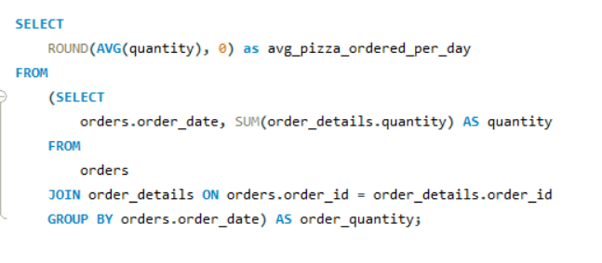
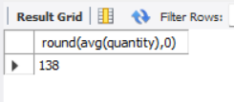
Group the orders by date and calculate the average number of pizzas ordered per day.

Slide 14
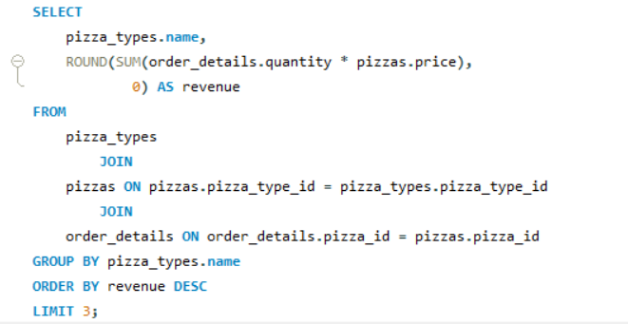
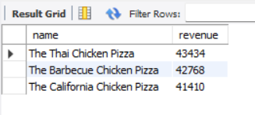
Determine the top 3 most ordered pizza types based on revenue.

Slide 15
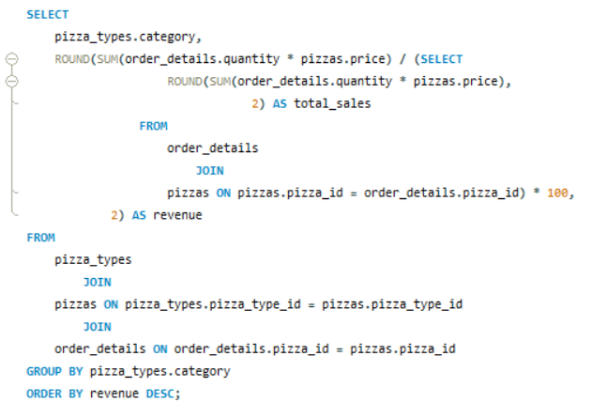
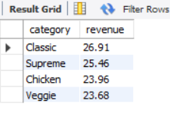
Calculate the percentage contribution of each pizza type to total revenue

Slide 16
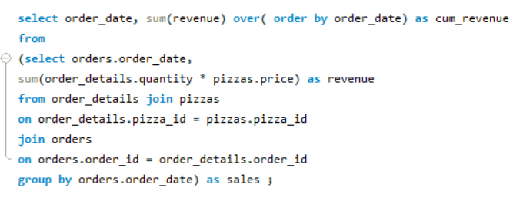
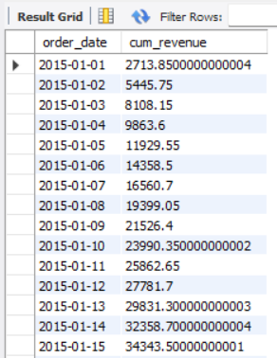
Analyze the cumulative revenue generated over time

Slide 17
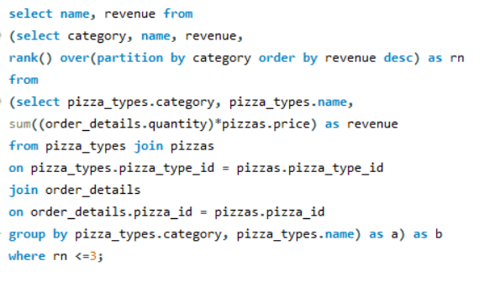
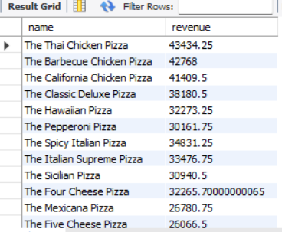
Determine the top 3 most ordered pizza types based on revenue for each pizza category

Slide 18
Thank You

